Slide 1
The Application of Tangible Geospatial
Modeling to Facilitate Sustainable Land Management Decisions
A Project Presentation By: Brent D. Fogleman
In partial fulfillment of the requirements for the degree of Master of
Geospatial Information Science and Technology
Advisor: Dr. Hugh Devine
With support from:
Dr. Helena Mitasova and Dr. Heather Cheshire
NC STATE UNIVERSITY

Slide 2
Motivation and Approach
Land managers at Fort Bragg informed me of erosion problems and recommended critical spots to study
Assist with the development of a leading edge, 3-dimensional geospatial modeling and simulation environment
Present an introduction to how the Tangible Geospatial Modeling System (TanGeoMS) can be applied to model an erosion problem on Fort Bragg
Propose analysis environment for simulating landform changes
Implemented several example scenarios

Slide 3
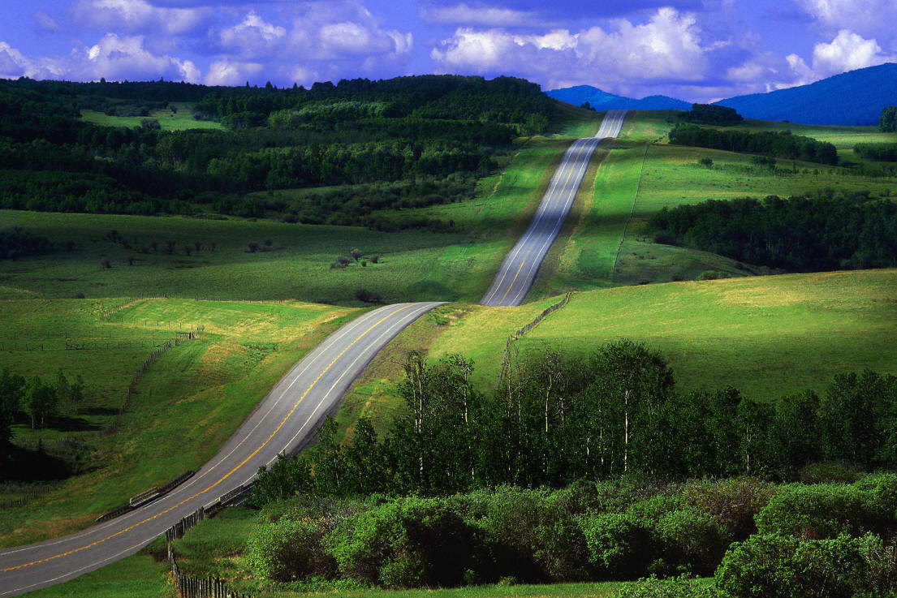
The Road We’re Taking Today
Orient you to the study site
Describe the problem
Take you on a tour of TanGeoMS
Show you how the models are constructed
A brief lesson on calculating soil erosion
Experiment with the model
Wrap up with
what’s next

Slide 4
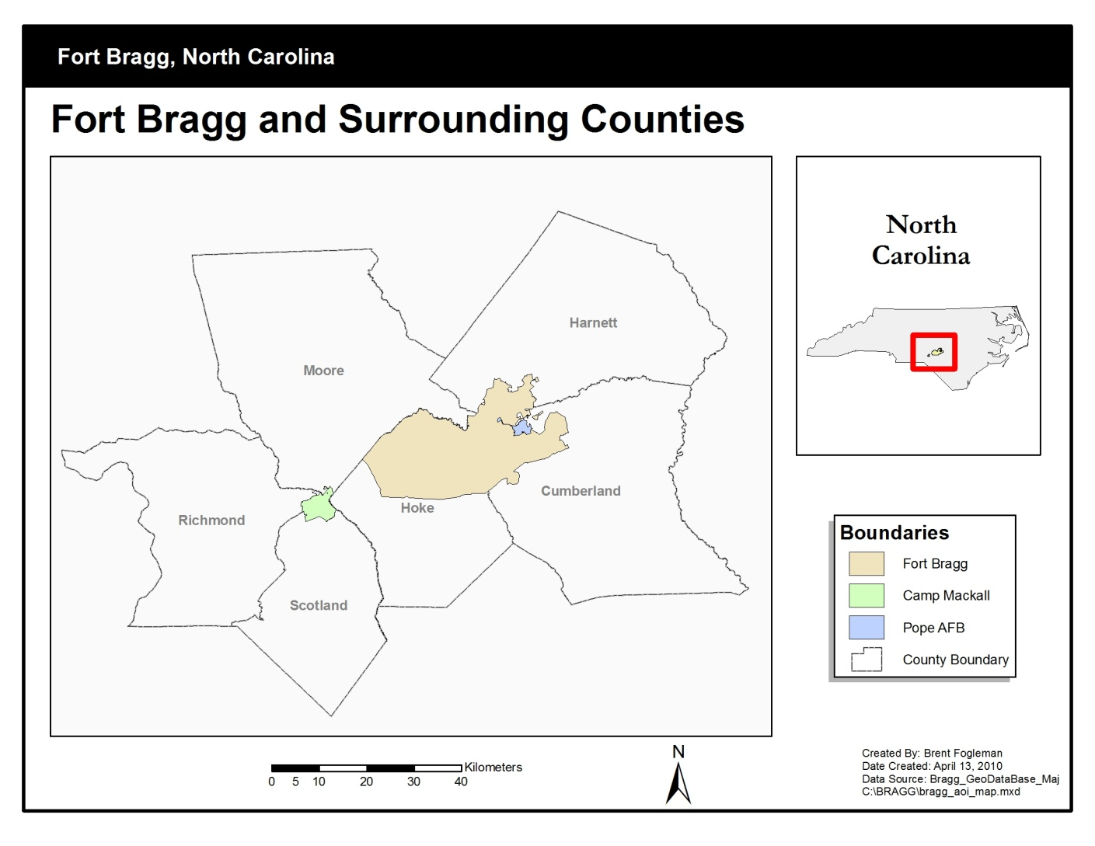
Study Region
Notes:
Fort Bragg is located in the sandhills region of North Carolina just west of Fayetteville.

Slide 5
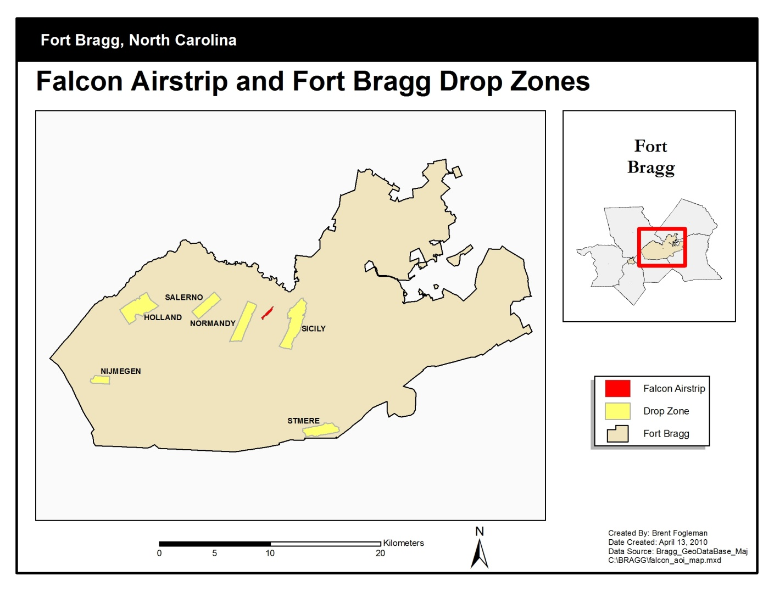
Study Area of Interest
Notes:
Falcon Airstrip is a training area in the north-central portion of Fort Bragg, North Carolina with a high volume of military vehicle and aircraft use.

Slide 6
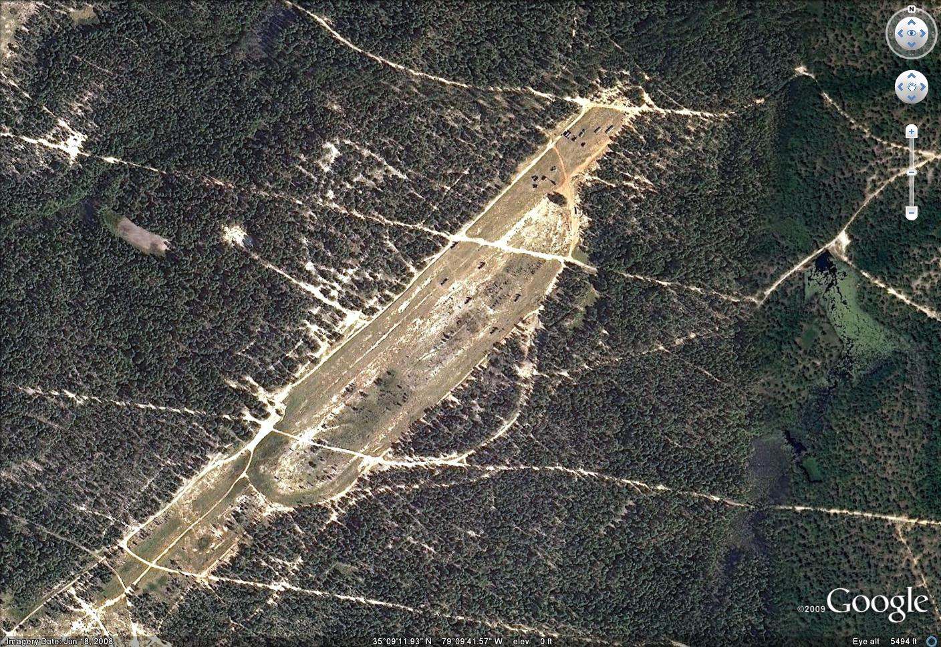
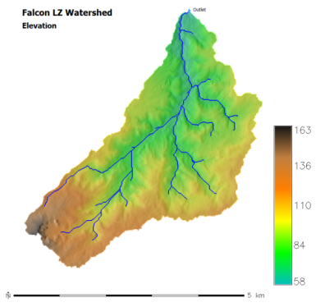
Study Area of Interest
Notes:
The dirt air strip and dirt roads are highly susceptible to erosion, caused by rainfall runoff, by heavy vehicular traffic, and by the forceful downdraft from helicopter rotors displacing loose soil.
Just by looking at the aerial photography, you can see all the bare soil, particularly on the airstrip and the dirt roads.
Make a mental note of the helicopters and vehicles on the airstrip.
The airstrip is contained within a watershed that is 13 square kilometers.

Slide 7
Ummmm, I think we may have a problem…
Oh really, what kind of problem?
Notes:
One might suspect that there are some environmental problems just by reviewing some remote sensing products. This site is of particular interest to the land managers at Fort Bragg, so I chose it as my study site.

Slide 8
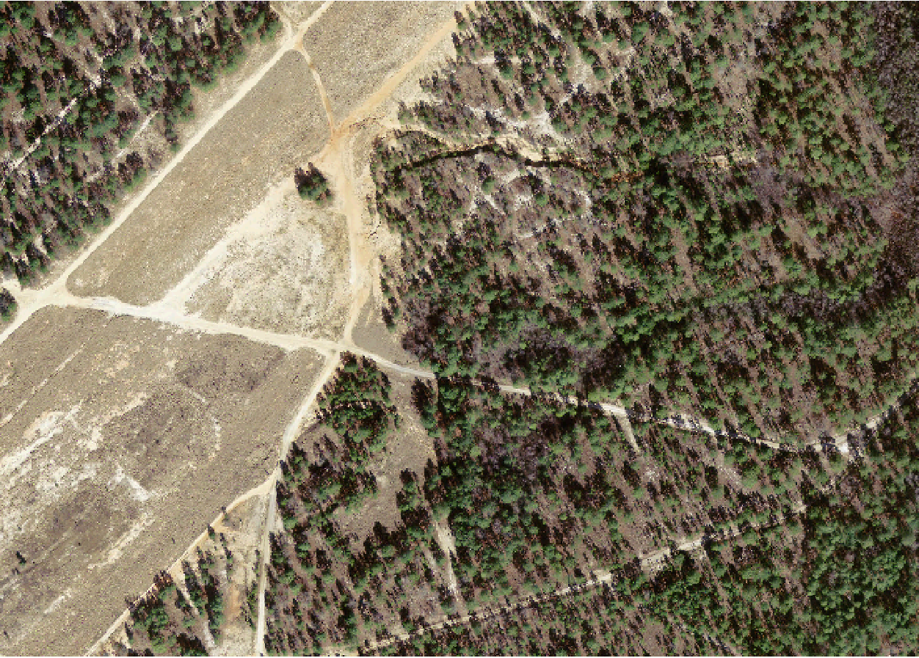
Study Site
86 acres
500 m
700 m
Notes:
As we zoom in to the study site, you may first notice how devoid the area is of ground cover. Take a closer look and quite noticeable is this large gully…the biggest erosion concern in this area.

Slide 9
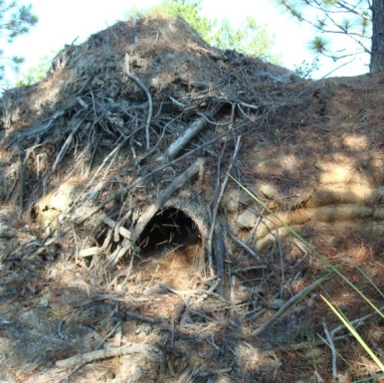
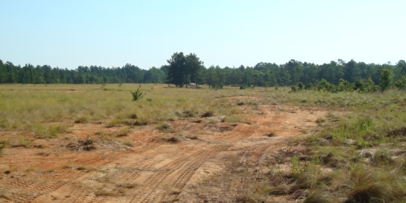
Making Matters Worse
B
A
B
A
Notes:
Exacerbating the problem is this drain pipe running under the road that concentrates flow into the gully.

Slide 10
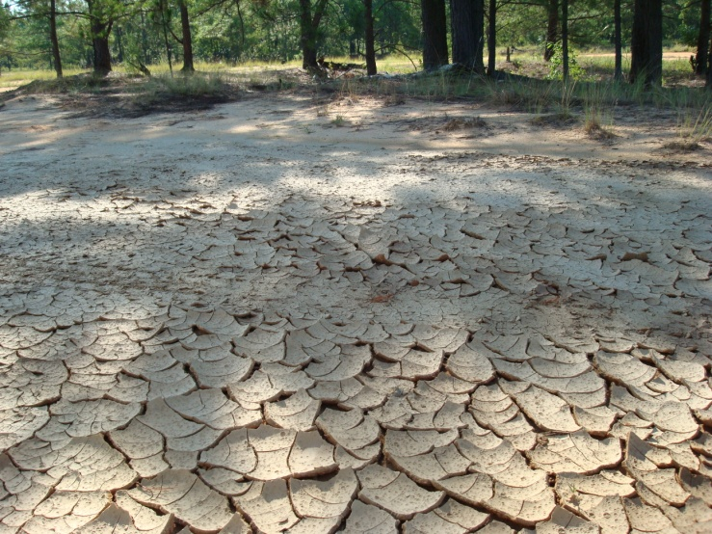
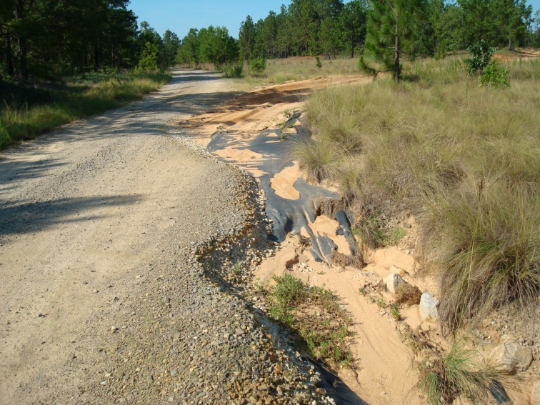
Erosion Examples
D
D
C
C
Notes:
Even on a dry day, it is apparent that rainfall runoff accumulates around the drain inlet.
This small gully along the road is representative of the gully erosion in and around the airstrip.

Slide 11
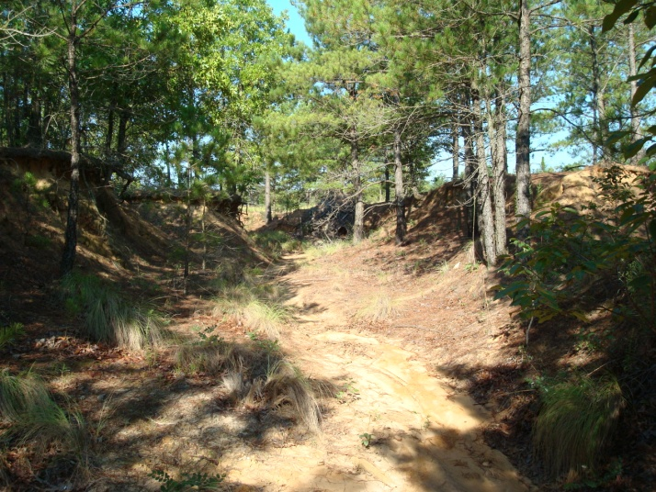
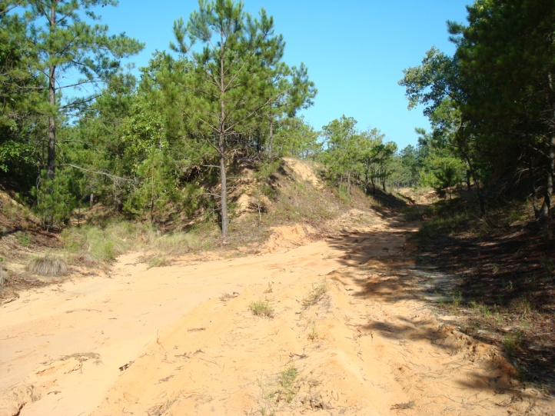
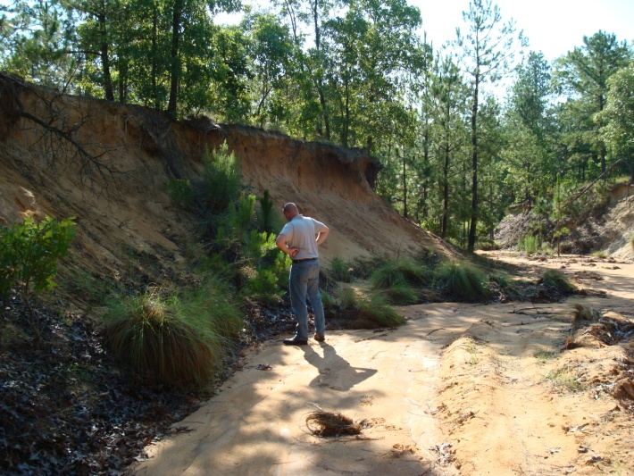
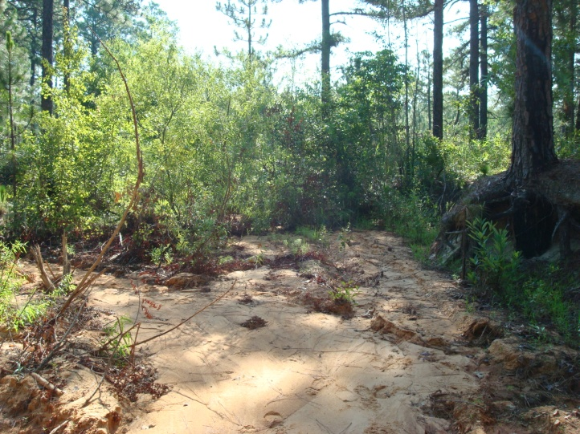
Gully Erosion
E
Water out
F
G
H
Wetland
6’3”
Notes:
The gully extends over 200 meters in length, is 33 meters wide at its widest and has depths up to four meters.
The concentrated flow generated in this gully carries sediment along its path until it deposits in the wetland.

Slide 12
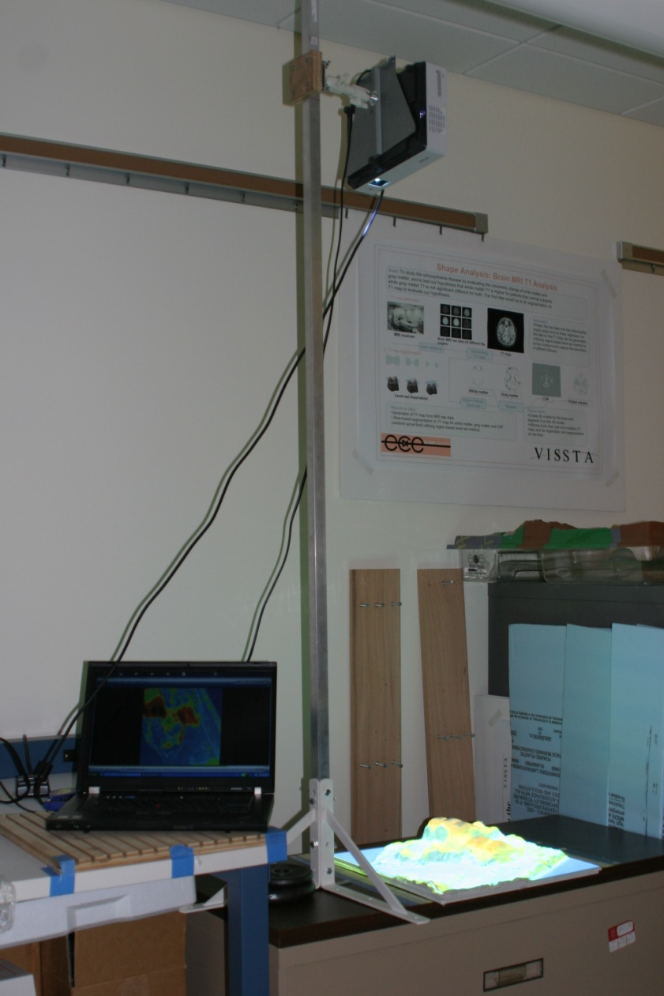
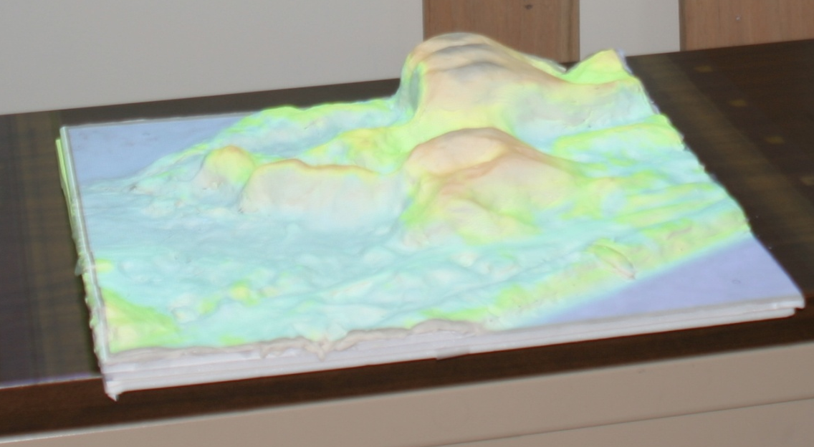
Tangible Geospatial Modeling System (TanGeoMS)
3D clay model
Projecting real data onto the model
Notes:
12
I introduce to you TanGeoMS: a tangible geospatial modeling system to facilitate decision-making.
This unique technology is at the leading edge of three-dimensional geospatial modeling and simulation.
Preliminary results indicate that this planning and evaluation environment has the potential to significantly assist land managers in their efforts to quantify environmentally sensitive problems and to aid in the development of sustainable practices.

Slide 13
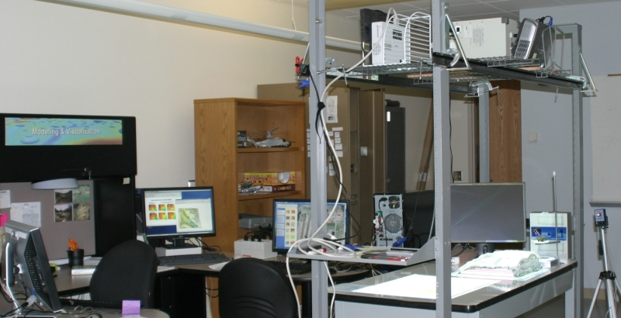
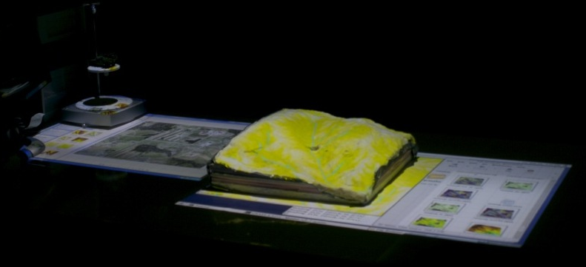
TanGeoMS at the VISSTA lab
3D scanners
projectors
3D display
workstations
flexible models
System is linked to GIS:
GRASS, ArcGIS -
both can be used simultaneously
Multipurpose facility at VISSTA Lab at ECE NCSU: Prof. Hamid Krim
Notes:
TanGeoMS takes advantage of a physical, three-dimensional terrain model coupled with a laser scanner, projector and a geospatial information system (GIS) to provide an interface for collaborative decision-making. Managers can examine their planned control measures in detail by modifying the physical model to represent their solution, capturing the results with a laser scanner and analyzing the results in a GIS interface. The resulting analysis is projected on the model, providing feedback on the impact of the terrain modifications and simulated processes. The feedback is used to improve existing designs and to develop subsequent scenarios.
The system workflow can be described in 7 steps…

Slide 14
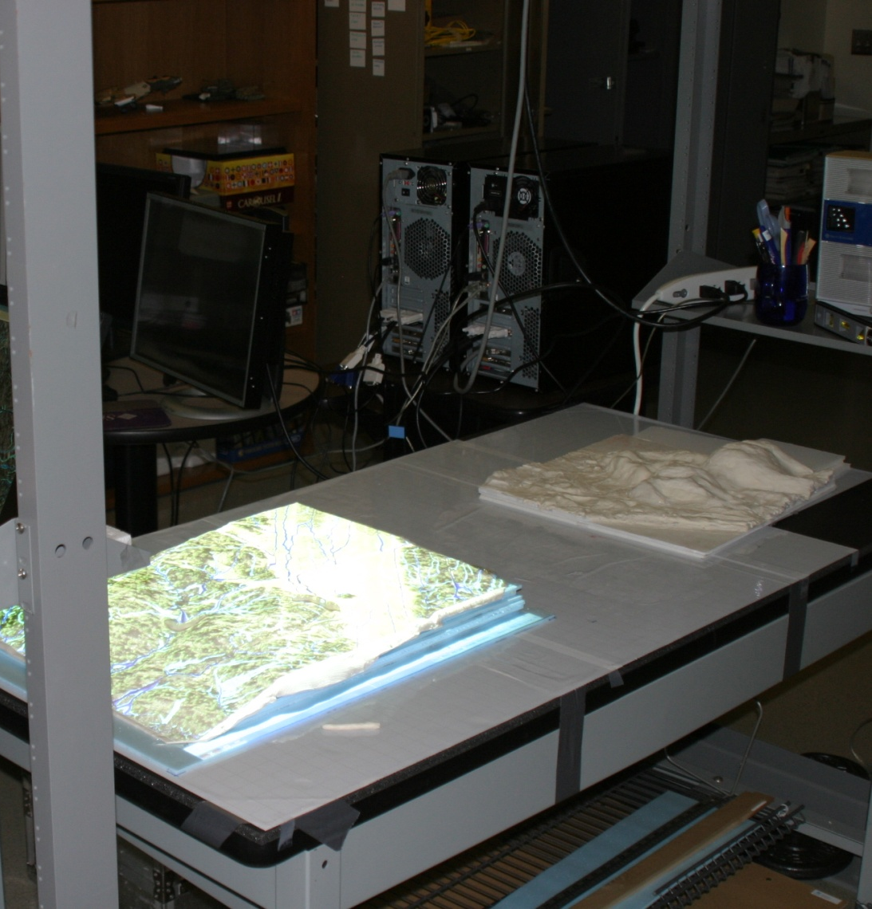
Workflow
Scanner
Scan
x,y,z tuples
Notes:
The scanner scans the model, producing an x,y,z tuple that is output to a text file.
The scanner generates nearly 300 thousand points.

Slide 15
Workflow
Scan
Scale and Georeference
Let N be the number of points in the point cloud, then the simplest method for this uses linear equations to scale the model and shift the data, converting each of i ϵ 1, ...,N scanner tuples, m_{i} =[m_{ix},m_{iy},m_{iz}], to a geographic tuple g_{i} = [g_{ix},g_{iy},g_{iz}] as follows:
g_{i} = amᵀᵢ + b
where the scaling vector, a = [a_{x},a_{y},a_{z}], is defined as
g_{jmax} – g_{jmin}
a_{j} = ───────
m_{jmax} – m_{jmin}
for j ϵ {x, y, z} and the shifting parameter, b can be calculated as
b = amᵀ_{o} + g₀
such that m₀ are g₀ are corresponding coordinates, such as the lower left corner of the model and the lower left corner of the geographic region, respectively, to anchor the relationship.
BUT….to simply apply it we run a shell script on the output file to rewrite all the scanner coordinates as scaled and georeferenced coordinates!
Notes:
In order to conduct analysis with the scanned data, it must be scaled and georeferenced. Separate scaling factors are applied to x, y and z coordinates. Essentially the equations make use of ground control points and fits them to the working coordinate system. This process is expedited by feeding the GCPs into a preformatted Excel worksheet to derive equation variables, which are written into a shell script and processed.

Slide 16

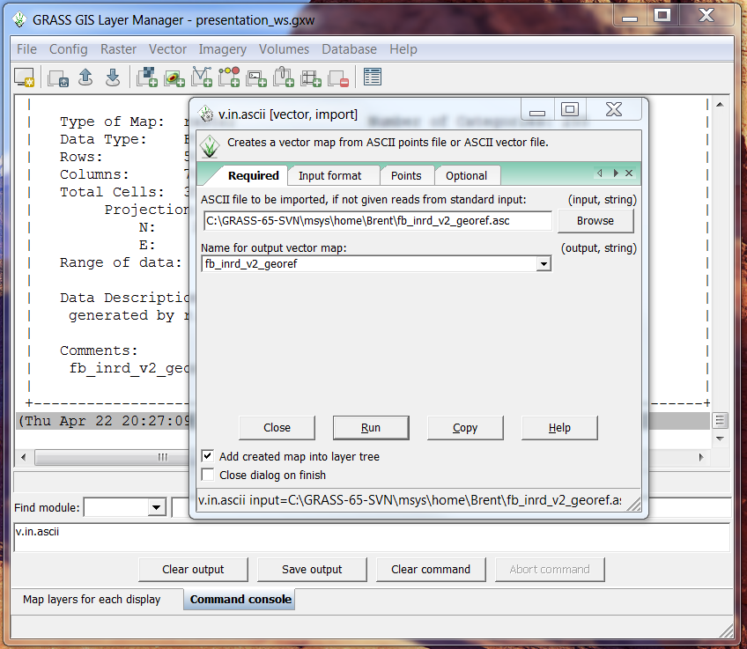
Workflow
Scan
Scale and Georeference
Import into GIS
GRASS GIS
Notes:
We import the georeferenced xyz point cloud data into GIS, generating a vector point data layer.
This is the same process used to import LIDAR point cloud data.

Slide 17
Workflow
Scan
Scale and Georeference
Import into GIS
Create a DEM
Notes:
Then we interpolate the vector points to create a digital surface model.

Slide 18

Workflow
Scan
Scale and Georeference
Import into GIS
Create a DEM
Conduct Analysis
  surface runoff
  soil erosion
  deposition
  solar irradiation
GRASS GIS
Notes:
Now we can conduct analysis.
Analysis can include any operation that a GIS can conduct on a LIDAR DEM.
Processes that can be modeled include surface runoff, soil erosion and deposition, and solar irradiation.

Slide 19
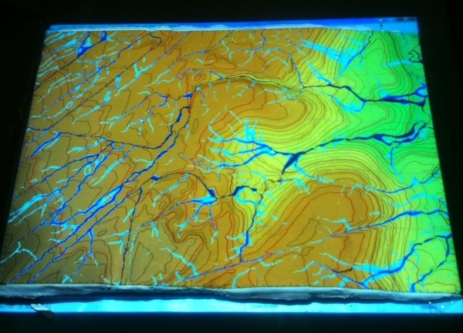
Workflow
Scan
Scale and Georeference
Import into GIS
Create a DEM
Conduct Analysis
Produce Feedback
Notes:
We can easily project the results of the analysis over the physical model to provide feedback, which can facilitate discussion.

Slide 20
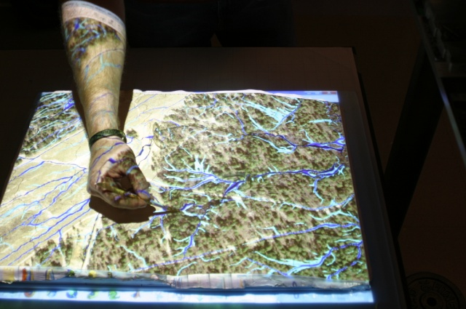
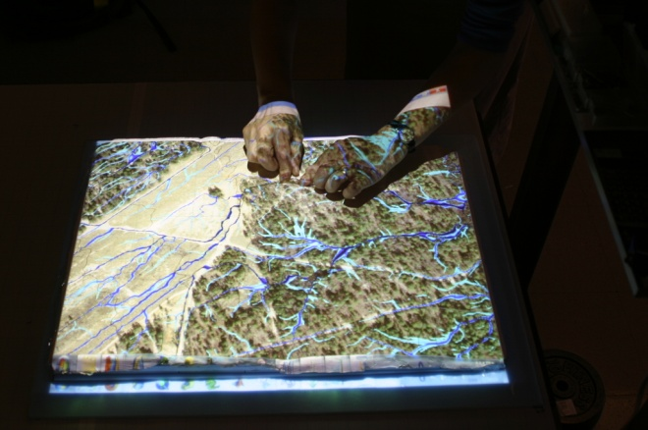
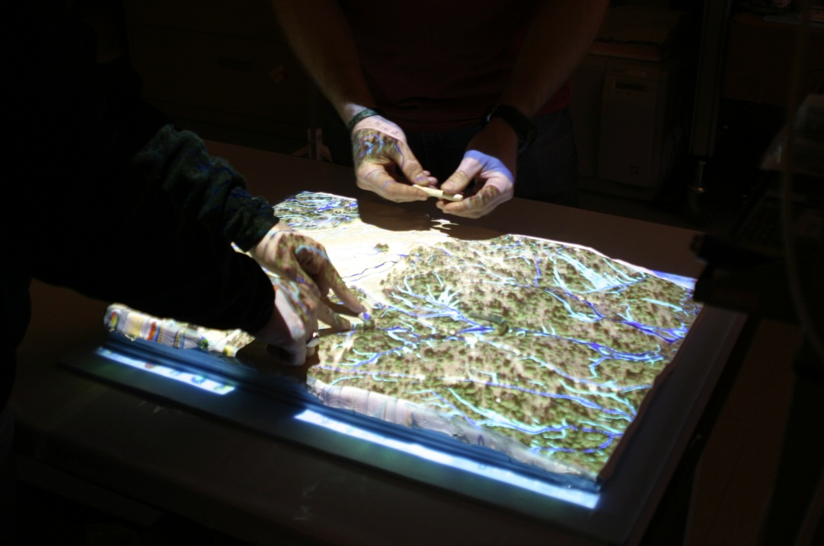
Workflow
Scan
Scale and Georeference
Import into GIS
Create a DEM
Conduct Analysis
Produce Feedback
Modify
Notes:
Modifications to the physical model can include adding objects to the surface or making modifications to the surface itself since the clay surface is malleable.
For example, users can experiment by adding objects, such as pieces of bubble wrap or styrofoam to represent real modifications to the landscape like forest or buildings or they use clay tools to dig into or sculpt the landscape

Slide 21
Let’s take a look at how it works
TanGIS video

Slide 22
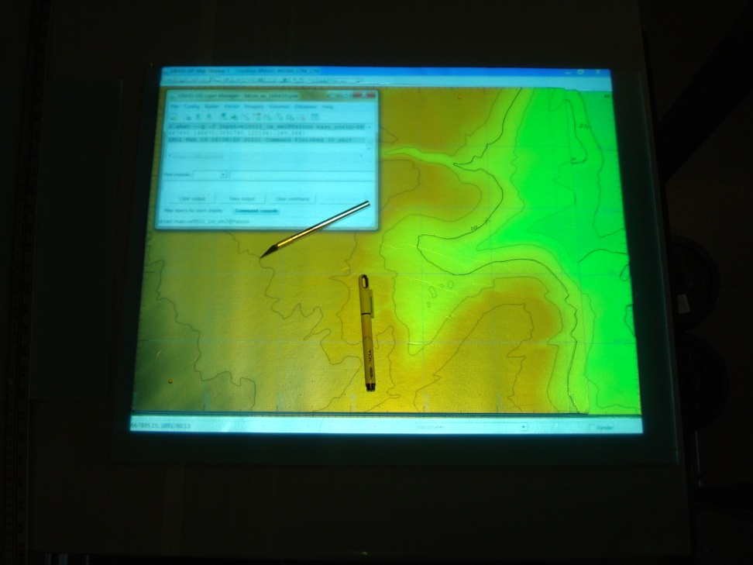
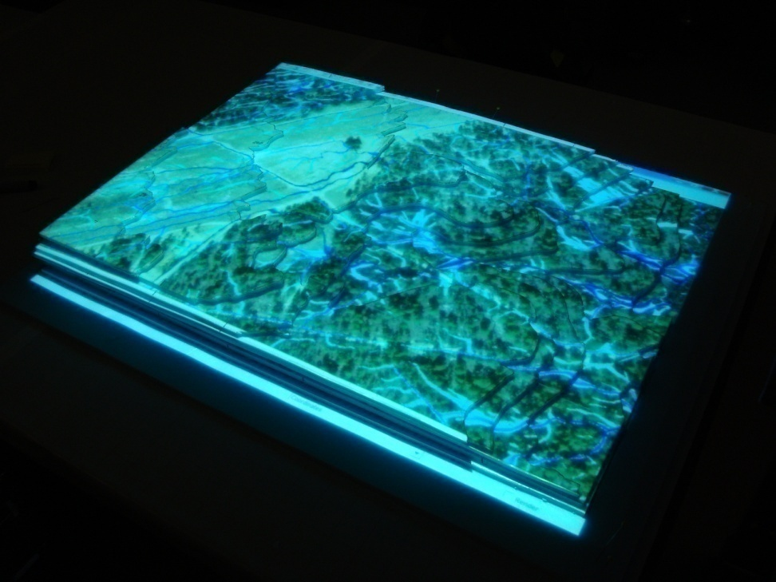
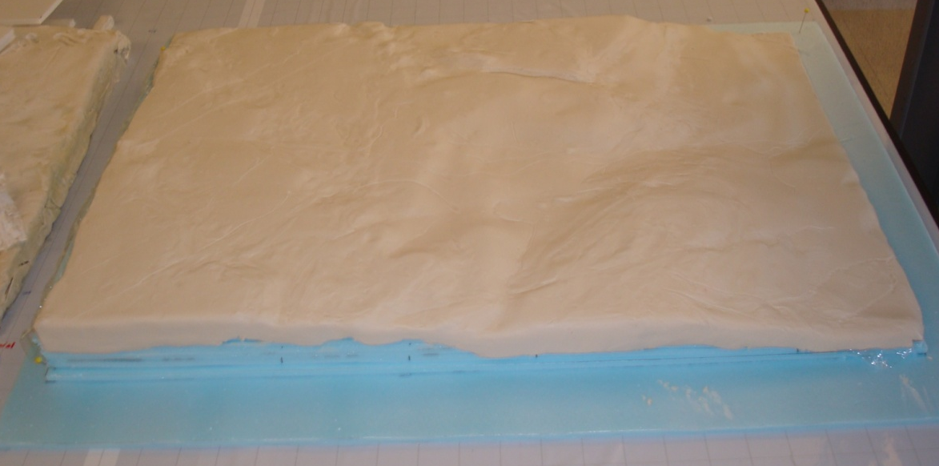
Model Construction
Time:
~ 6 hours
Cost:
~ $50
Notes:
The physical model of Falcon Airstrip used in this project was manually constructed.
The base of the model is made of 6mm insulating foam found at a typical home improvement store.
Contours are projected onto the foam working surface, traced with a marker, then cut out with a razor knife.
The layers are then stacked and secured in place with T-pins.
Blocks of plasticine are rolled out until a smooth surface of about 3mm is achieved. The clay is draped over the 3-D contours and edges smoothed together.
Final shaping is done with clay modeling tools.

Slide 23
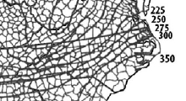

Revised Universal Soil Loss Equation (RUSLE3D)
A soil loss per unit area
R rainfall erosivity factor
K soil-erodibility factor
LS length/slope steepness factor
C cover factor
P conservation support practice factor
Soil Maps
Computed
Derived
from
reference
tables
Notes:
One of the modeled processes I will demonstrate is calculating erosion potential. I want to give you a quick lesson on a method to calculate erosion potential. The Universal Soil Loss Equation came out of Perdue and was published in 1954 by the Department of Agriculture. The equation was designed to calculate soil loss potential in agricultural fields, but modelers have adapted it to other landscapes.
R represents a measure of the erosive force and intensity of rain in a normal year. The value was visually interpolated from an isoerodent map.
K is a measure of a soil’s susceptibility to erosion. A spatially-variable K-factor raster map was created to more accurately assess soil loss potential.
LS represents the combined effect of slope length and slope steepness on erosion.
U is the upslope area per unit width
β is the slope angle in degrees
22.1m is the length of the standard USLE plot
0.09=9% is the slope of the standard USLE plot
m and n are empirical constants
C accounts for the effects of ground cover on soil erosion
P accounts for erosion control effectiveness of landscape treatments such as contouring, terracing, and establishing sediment basins.
23

Slide 24
Notes:
In a moment I will show you on the model how we move along through the process of setting it up, manipulating it and receiving the feedback. Talk about what we are going to do next.
Talk about that I already conducted the analysis in the lab and now we are going to show the feedback.
I made this TanGeoMS mobile station so the feedback loop can be shared in a variety of settings, rather than constraining all operations to a lab environment.
As we move into the model demonstration, don’t be too concerned about the erosion rates, but I will have them up on the main screen for your reference.

Slide 25
Hands on Demonstration
Please stand….
S – T – R – E – T – C – H
and join me around the model

Slide 26
 | Spatially variable Factor C with weighted and non-weighted flow
 |  | Real world DEM |  | Initial Model State |  | Fill Dam 1 |  | Fill Dam 2 |  | Fill Dam 3 |  | Grade 3 |  | Rip Rap
 |  | non-weighted flow | weighted flow | non-weighted flow | weighted flow | non-weighted flow | weighted flow | non-weighted flow | weighted flow | non-weighted flow | weighted flow | non-weighted flow | weighted flow | non-weighted flow | weighted flow
 | Soil loss potential tons/(acre.year) | 39.34 | 31.90 | 35.72 | 29.11 | 40.63 | 32.47 | 41.11 | 32.93 | 38.45 | 31.08 | 41.42 | 33.74 | 37.95 | 31.22
 | Percent change from real world |  |  | -9.18 | -8.72
 | Percent change from initial model state |  |  |  |  | 13.74 | 11.52 | 15.09 | 13.12 | 7.63 | 6.76 | 15.95 | 15.90 | 6.22 | 7.22
 | Variable Erosion based on flow concentration with spatially variable Factor C
 |  | Real world DEM |  | Initial Model State |  | Fill Dam 1 |  | Fill Dam 2 |  | Fill Dam 3 |  | Grade 3 |  | Rip Rap
 |  | erosion in light flow areas | erosion in concen-trated flow areas | erosion in light flow areas | erosion in concen-trated flow areas | erosion in light flow areas | erosion in concen-trated flow areas | erosion in light flow areas | erosion in concen-trated flow areas | erosion in light flow areas | erosion in concen-trated flow areas | erosion in light flow areas | erosion in concen-trated flow areas | erosion in light flow areas | erosion in concen-trated flow areas
 | Soil loss potential tons/(acre.year) | 26.32 | 450.28 | 24.28 | 439.27 | 24.54 | 570.14 | 25.01 | 579.54 | 24.47 | 530.28 | 26.73 | 497.94 | 24.41 | 541.64
 | Percent change from real world |  |  | -7.75 | -2.45
 | Percent change from initial model state |  |  |  |  | 1.06 | 29.79 | 3.00 | 31.93 | 0.78 | 20.72 | 10.11 | 13.36 | 0.53 | 23.31
 | Uniform Factor C = 0.1 with weighted and non-weighted flow
 |  | Real world DEM |  | Initial Model State |  | Fill Dam 1 |  | Fill Dam 2 |  | Fill Dam 3 |  | Grade 3 |  | Rip Rap
 |  | non-weighted flow | weighted flow | non-weighted flow | weighted flow | non-weighted flow | weighted flow | non-weighted flow | weighted flow | non-weighted flow | weighted flow | non-weighted flow | weighted flow | non-weighted flow | weighted flow
 | Soil loss potential tons/(acre.year) | 8.44 | 6.26 | 7.74 | 5.81 | 8.23 | 5.93 | 8.34 | 6.03 | 7.99 | 5.83 | 8.51 | 6.29 | 8.41 | 6.35
 | Percent change from real world |  |  | -8.28 | -7.23
 | Percent change from initial model state |  |  |  |  | 6.32 | 2.02 | 7.70 | 3.75 | 3.18 | 0.35 | 9.94 | 8.21 | 8.65 | 9.35

Slide 27
What is next for TanGeoMS?
Fully automate the system through seamless integration of hardware and software in order to produce immediate feedback
Explore the functionality of multi-scale modeling
Test in different operational environments
  Military Operational Planning
  GIS Working Groups
  Instructional Environments
Notes:
TanGeoMS is being actively used in a research oriented environment and further enhancements to the hardware and software are required before it is capable for routine applications. While this technology is currently being used to model natural processes, it has great potential to serve in other capacities.

Slide 28

Multi-scale
What’s Next…
1-m resolution
10-m resolution
Notes:
Advancements to the TanGeoMS include exploration into the functionality of using a multi-scale digital model, a technique not currently used in this modeling approach. A one-meter resolution LIDAR dataset covering the entire 13km² watershed equates to nearly one gigabyte of data to process for each simulation.
Essentially, TanGeoMS will scan and compute data from the high resolution physical model, concurrently accounting for lower resolution data from a “virtual landscape” in its calculations.
A multi-scale model accomplishes two main objectives: 1) accounts for flow accumulation for the entire watershed; and 2) facilitates faster computation of flow accumulation.

Slide 29
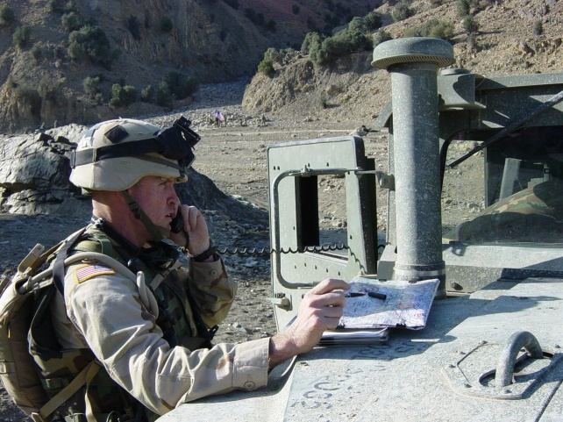
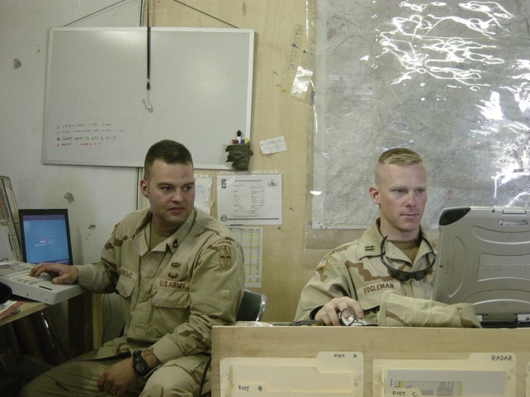
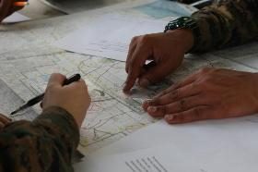


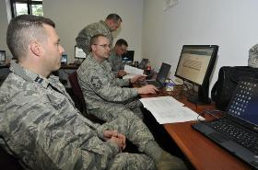
Military Operational Planning Environment
What’s Next…
Collaborative
Compliments MDMP
Visual
Virtual Environment
Notes:
This technology has great potential to be applied to military operational planning.
The real-time feedback and collaborative nature of the method compliments the Military Decision-Making Process.

Slide 30
GIS Working Group Environment
What’s Next…
Groups requiring collaboration
A new way of looking at spatial problems
New method to define problems
Aid in the development of sustainable practices
Notes:
The subject matter of this study came from a need by U.S. Army land managers at Fort Bragg who are interested in new methods to define environmental impact problems and to determine solutions in a collaborative environment. Preliminary results indicate that this planning and evaluation environment has the potential to significantly assist land managers in their efforts to quantify environmentally sensitive problems and to aid in the development of sustainable practices.

Slide 31

Instructional Environments
What’s Next…
Increased learning potential
Direct exposure to virtual environment
Active participation in a vivid environment
Enhanced interest in learning
Enhances “spatial thinking”
Added level of perception
Promotion from mere knowledge of spatial relationships to understanding them
Notes:
The learning potential resulting from the visualization capabilities of TanGeoMS is significant.
Students can benefit greatly from direct exposure to actual or virtual environments and presenting distributional relationships among spatial phenomena in an active and vivid manner can enhance student interest in learning geography.
TanGeoMS can enhance “spatial thinking” through its hands-on virtual environment in which students have the opportunity to gain a better understanding of relationships within spatial configurations. This added level of perception (information) applied in a conventional classroom learning environment may promote students from having mere knowledge of spatial relationships to understanding them.

Slide 32
Conclusion
TanGeoMS is an innovative approach to spatial problem solving
Provides a collaborative environment that facilitates discussion about potential solutions
Allows us to experiment with land form change and how natural processes are affected
Facilitates the decision-making process
And, quite frankly, it’s pretty cool!
Notes:
The design environment created by TanGeoMS greatly facilitates a collaborative effort amongst staffs with similar goals and objectives. The real-time feedback provided by the system in a collaborative setting may equate to greater efficiency in the planning phase, equating to a faster response, or execution of the plan. With further development, TanGeoMS can be launched from its research environment into the world to augment any team confronted with three-dimensional geospatial problems.

Slide 33
Thank you for attending my presentation.
NC STATE UNIVERSITY
Notes:
Thank you for attending my presentation.
I will now field your questions.

